Slide 1
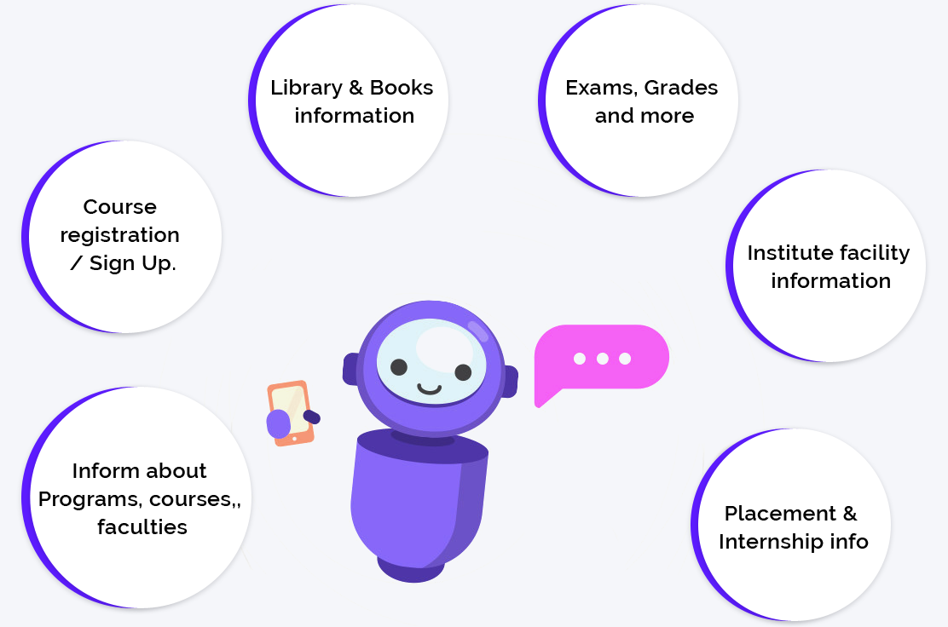
Parkside ChatBot Group
Sprint 1 Demo
Team Members:
Aaron
Brandon
Chris
Eli
Jose
Date: 2/20/24

Slide 2

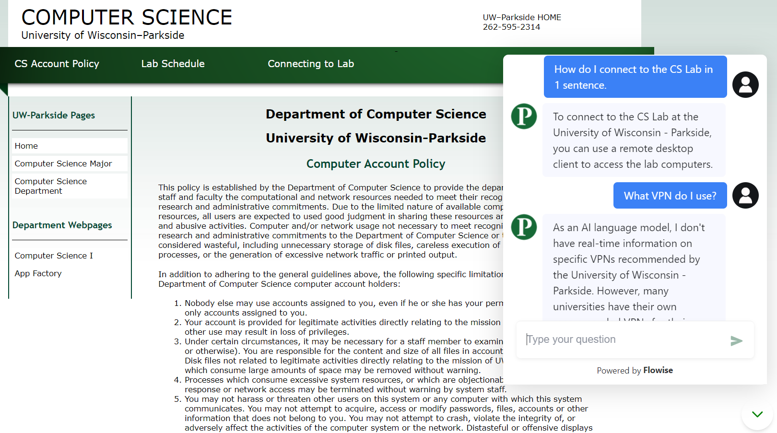
Welcome Back & Project Recap
Project Mission:
Reduce the barrier to entry for successful post-secondary education at Parkside, aiding both students and faculty.
Last Semester's Success:
Deployed a locally running LLM fine-tuned on Parkside information, with room for process improvements and additional features.
This Semester's Focus:
Transition to cloud-based, client-side LLM setup for enhanced scalability, efficiency, while utilizing each team member’s strengths.
‎

Slide 3
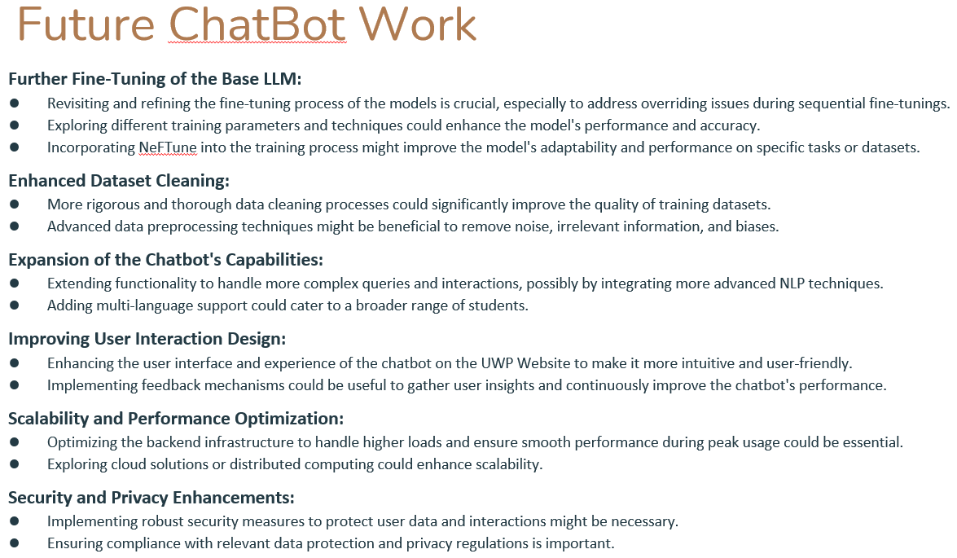
Team Overview & Sprint 1 Tasks
Aaron: Frontend Optimization, Dataset and Finetuning Process Refinement Research
Brandon: RAG & Vectorized Database Research
Chris: Codebase Refactoring & Client-Side LLM Research
Eli: Strategic Planning, Onboarding, AI Advance Research
Jose: Website and LMStudio Migration to Cloud
‎

Slide 4

Sprint Accomplishments
‎

Slide 5
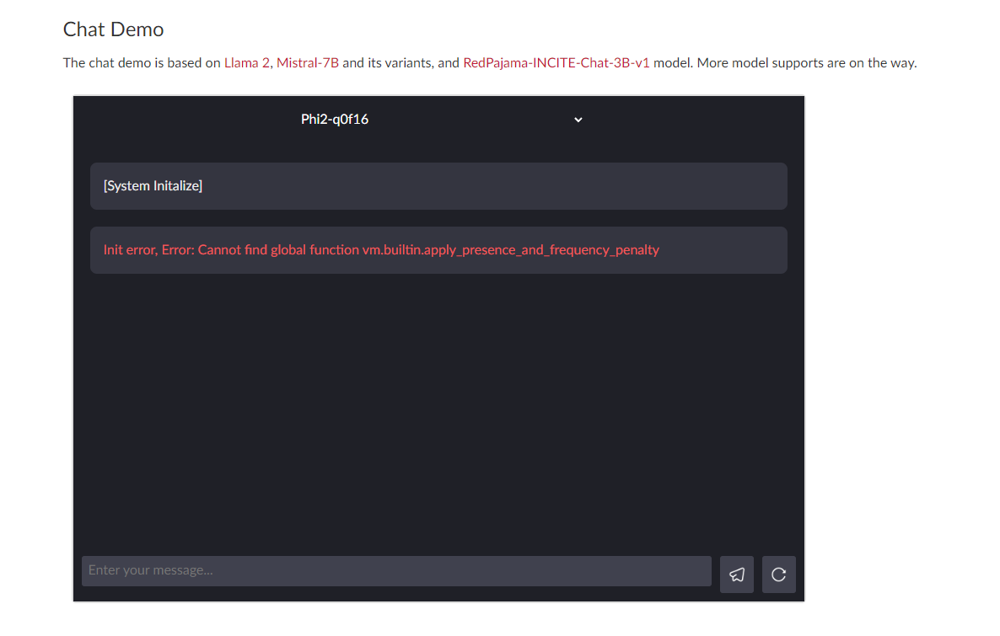
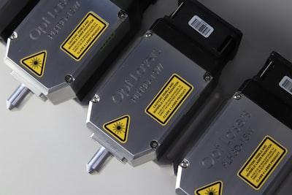
Overcoming Challenges
Discovering Latest AI Advances and Tools
Assessing Relevance of AI Advances
Onboarding New Team Members
Adjusting Project Scope and Tasks
Transitioning from LangChain and LMStudio to WebLLM and Cloud Services
WebLLM Demo Errors and Documentation Gaps
‎

Slide 6

Looking Ahead: Sprint 2 Goals
Dataset Improvement and Fine-Tuning
Backend Refactoring for Client-Side Execution
Security/App Research
Integration of Vector Database
Model Training Process Optimization and Execution
Cloud Solution Plan and Implementation
‎

